Slide 1

Maleev Dmitriy

Slide 2

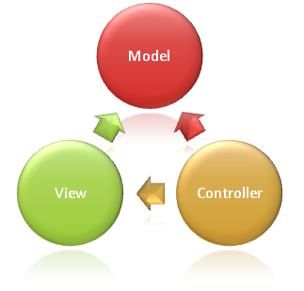
Web Framework which implements MVC pattern.(с) Captain Obvious!

Slide 3

Razor
Multiply View Engines
Dynamic View and ViewModel
Global Filters
JsonValueProvider
.NET 4.0 Validaiton/Metdata Attributes
Action Result types
Service Location and DI
…

Slide 4


Slide 5
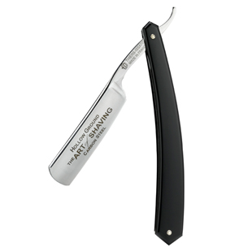

Slide 6

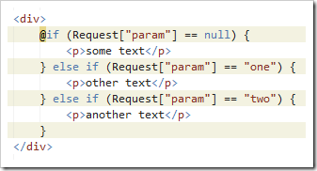
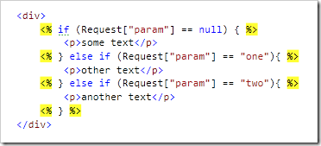
And say “Hello” to helpers!

Slide 7
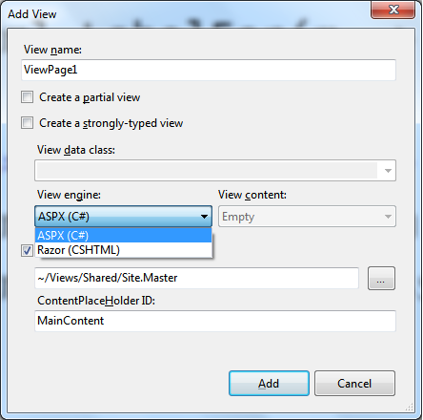

Slide 8
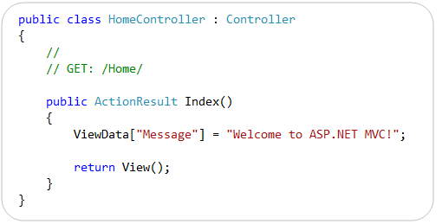
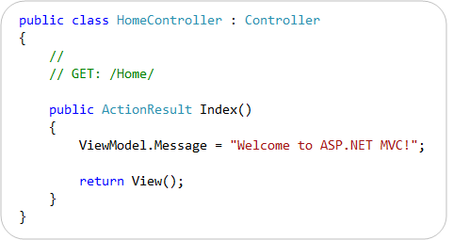

It was
It is
Feel the power of dynamic

Slide 9
jQuery Validation
Unobtrusive
jQuery-Based Ajax

Slide 10
Yesterday
Applying one filter for all actions in controller.
Then applying one filter for all controllers.
If we have 10 controller with 5 actions – we need to apply one filter 50 times!
Oh no! We need to apply one more filter ☹ Ctrl+C Ctrl+V madness!
Now
I am using Global Filters ☺

Slide 11
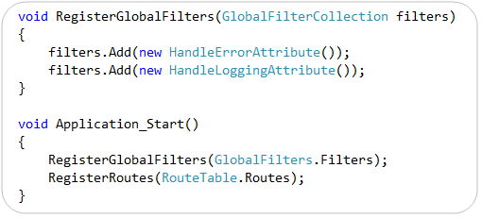

Slide 12
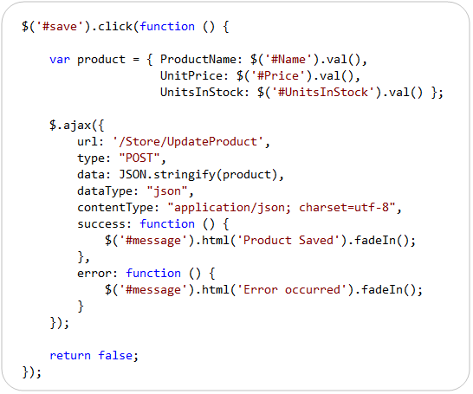
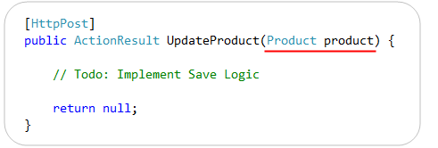
Will work with out Futures Libraries!

Slide 13
Model Validation
  DataAnnotations
  ValidationAttribute
  IClientValidatable
  IValidatableObject
Action Validation
  ValidateInput

Slide 14
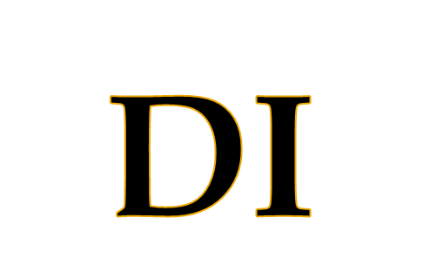

Slide 15

Action Results
Permanent Redirect
@model
_viewstart.cshtml
VBHTML

Slide 16
DEMO

Slide 17

Introducing ASP.NET MVC 3 (Preview 1)
  http://www.asp.net/learn/whitepapers/mvc3-release-notes
ASP.NET MVC 3 DI
  http://bradwilson.typepad.com/blog/2010/07/service-location-pt1-introduction.html
Lviv .Net User Group
  http://dotnetug-lviv.blogspot.com/

Slide 18
?

Slide 19

Skype me:
  hmmdima
Twit me:
  dimko1
Email me:
  diwingless@gmail.com

